Slide 1
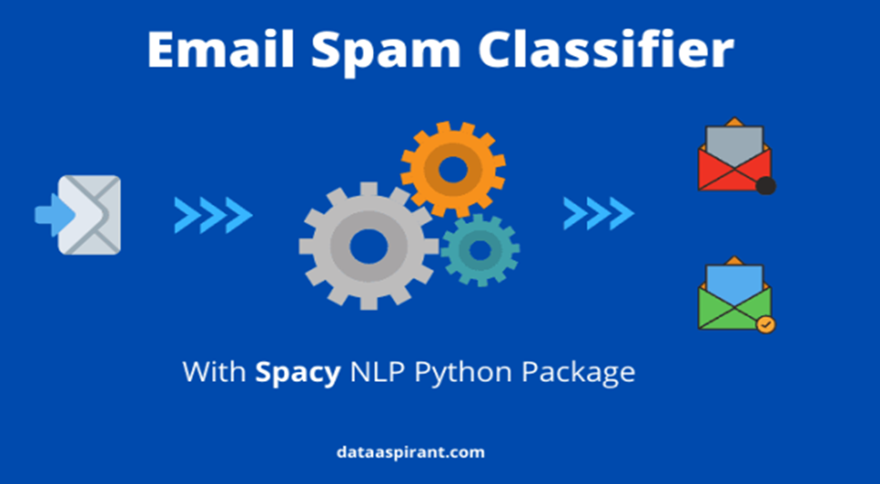
Email Spam Classifier
Presentation On
Presented By:
B.Sheeba rani
Batch no.1844

Slide 2
Agenda
Introduction
Problem Statement
Problem Understanding
Data Analysis & Model Building Flowchart
Exploratory Data Analysis Steps
Visualizations
Data Analysis Steps Done
Model Building
Hyper Parameter Tuning & Creating Final Model
ROC AUC Curve
Saving the model and prediction results
Conclusion

Slide 3
Introduction
Most of us consider spam emails as one which is annoying and repetitively used for purpose of advertisement and brand promotion. We keep on blocking such email-ids but it is of no use as spam emails are still prevalent.
Some major categories of spam emails that are causing great risk to security, such as fraudulent e-mails, identify theft, hacking, viruses, and malware. In order to deal with spam emails, we need to build a robust real-time email spam classifier that can efficiently and correctly flag the incoming mail spam, if it is a spam message or looks like a spam message. The latter will further help to build an Anti-Spam Filter.
Google and other email services are providing utility for flagging email spam but are still in the infancy stage and need regular feedback from the end-user. Also, popular email services such as Gmail, Yandex, yahoo mail, etc provide basic services as free to the end-user and that of course comes with EULA.
There is a great scope in building email spam classifiers, as the private companies run their own email servers and want them to be more secure because of the confidential data, in such cases email spam classifier solutions can be provided to such companies.

Slide 4
Problem Statement
In this project we need to build a model which can be used to predict in terms of a probability and The main goal of these two parts of article is to show how you could design a spam filtering system from scratch.
The SMS Spam Collection is a set of SMS tagged messages that have been collected for SMS Spam research. It contains one set of SMS messages in English of 5,574 messages, tagged according being ham (legitimate) or spam..

Slide 5
Problem Understanding
The email spam classifier focuses on either header, subject, and content of the email. In this project, we are focusing mainly on the subject and content of the email.
Email spam classification done using traditional machine learning techniques comprise Baive Bayes and SVM (support vector machines), due to not having sufficient hardware resources, takes less time to train. Also, not opting for neural algorithms due to less data and computing resources
: Both are good at handling large number of features; in the case of text classification each word is a feature and we have thousands of words based on the vocabulary of the corpus. SVM works best with high dimensional data, a vocabulary with 1000 words means each text in the corpus will be represented with a vector of 1000 dimension.

Slide 6
Data Analysis and Model Building Flowchart
+
Import Libraries
Import Dataset
Data Preprocessing
Data Balancing
Identifying Outliers and Skewness
Visualizations (EDA)
Model Building
Hyper Parameter Tuning
AUC-ROC Curve & Saving Model

Slide 7
Exploratory Data Analysis (EDA) Steps
Importing necessary libraries and importing dataset as a data frame.
Checked some statistical information like shape, number of unique values present, info, finding zero values etc.
Dropped some columns containing more than 90% of zero values assuming they won’t create skewness in later part.
Dataset was free from null values that is I found no missing values.
Extracted Day, Month and Year features from date column.
Found some negative/invalid values while checking the statistical summary of the dataset so, converted them into positive by using absolute command.
Visualizing the features using univariate and bivariate analysis. Univariate analysis is the simplest form of analysing the data. “Uni” means “one” , visualizing the data using one variable. Bivariate analysis is another form of analysing the data. “Bi” means “two” , visualizing the data using 2 variables.

Slide 8
Data Analysis Steps done
I have done feature engineering steps like feature extraction and feature selection to improve data normality and linearity.
Identified outliers using boxplots and removed outliers using percentile method.
Identified skewness using distribution plots and removed skewness using power transformation method
(yeo-johnson method).
Used Pearson’s correlation coefficient to check the correlation between dependent and independent variables. To visualize the correlation . I have used heatmap and bar plot.
I have used MinMaxScalar method to scale the data to overcome with the issue of data biasness.
Balanced the data using SMOTE oversampling mechanism.
Split train and test to build machine learning models . Model building process will be shown in the further steps.

Slide 9
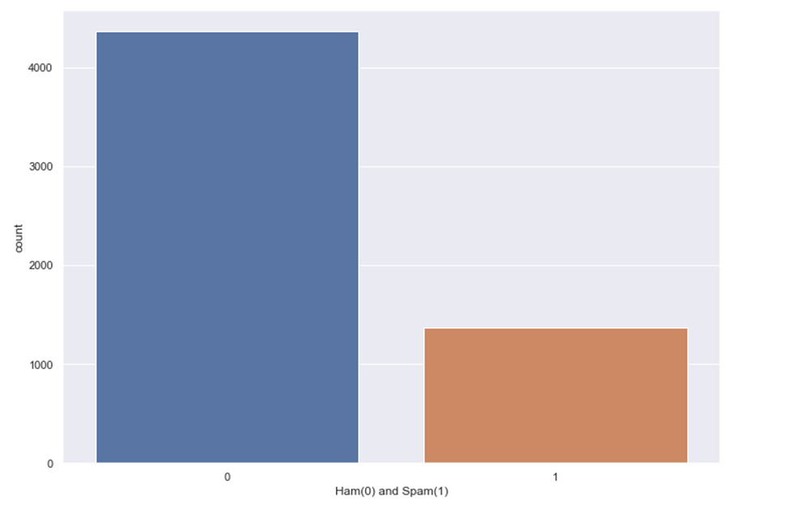
Data exploration: The bar graph given below depicts the percentage of Ham and Spam emails in the given dataset. The blue bar represents the count of ham emails and the red bar shows the count of spam emails in the dataset.

Slide 10
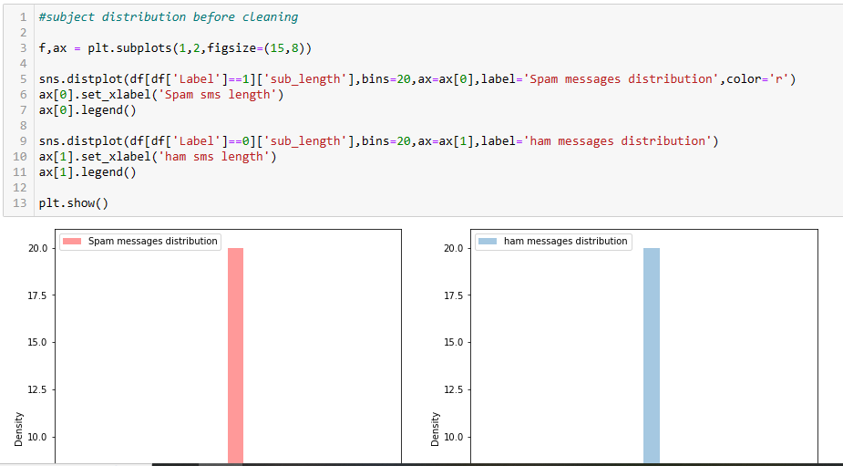
Message distribution before cleaning:

Slide 11
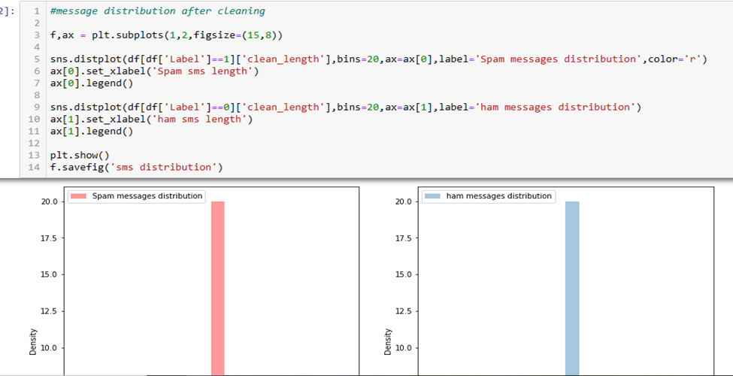
Message distribution after cleaning:

Slide 12
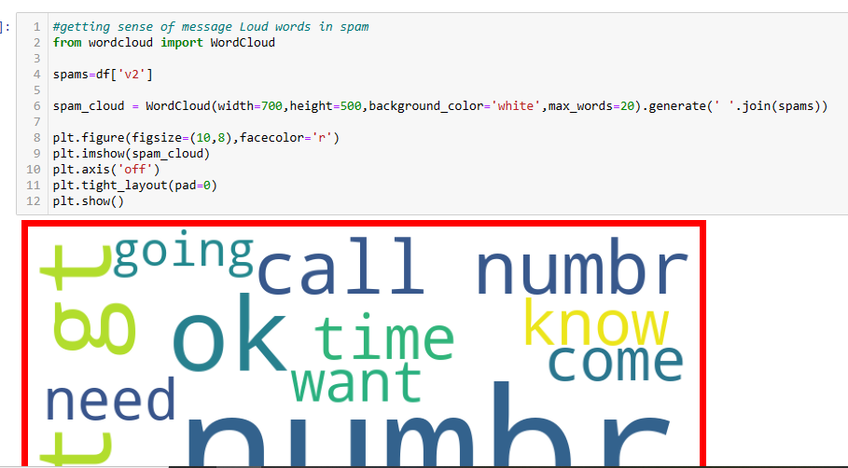
Word cloud in spam emails

Slide 13
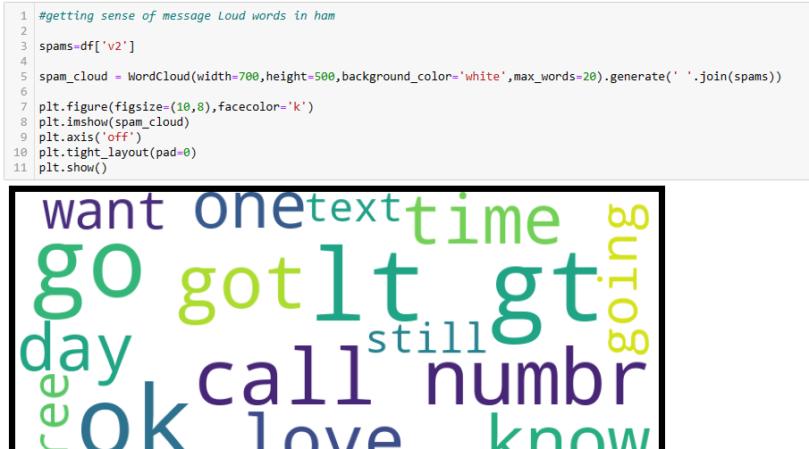
Word cloud in ham emails

Slide 14
Model Building
In this problem label is our target variable which is categorical in nature that is the Label ‘1’ indicates that the loan has been paid i.e., “non-defaulter”, while Label’0’ indicates that the loan has not been paid i.e. , “defaulter”. From this I can conclude that it is a Classification type problem hence I have used following regression algorithms.
After the pre-processing and data cleaning I left with 27 columns including target and with the help of feature importance bar graph I used these independent features for model building and prediction . The algorithms used on training the data are as follows :-
i. Decision Tree Classifier
ii. Random Forest Classifier
iii. Extra Trees Classifier
iv. Gradient Boosting Classifier
v. Bagging Classifier
I have got the best random state and maximum R2 score and then created train test split to build the above models.

Slide 15
1. Decision Tree Classifier
Created Decision Tree Classifier model and checked for its evaluation metrics and model is giving accuracy as 99.1 % and cross val. Score is 98.9

Slide 16
2. Random Forest Classifier
Created Random Forest Classifier model and checked for its evaluation metrics and model is giving accuracy as 99.3%

Slide 17
3. Extra Trees Classifier
Created Extra Trees Classifier model and checked for its evaluation metrics and model is giving accuracy as 95%

Slide 18
4. Gradient Boosting Classifier
Created Gradient Boosting Classifier model and checked for its evaluation metrics and model is giving accuracy as 89%

Slide 19
5. Bagging Classifier
Created Bagging Classifier model and checked for its evaluation metrics and model is giving accuracy as 95 %

Slide 20
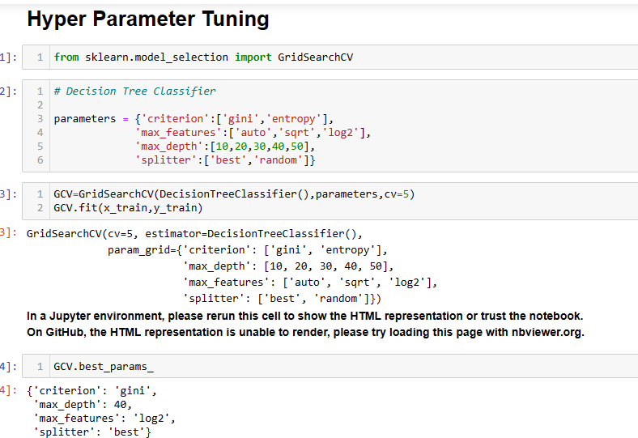
Hyper Parameter Tuning
From The difference between accuracy and cross validation score, Decision Tree Classifier Has least difference compared to other models. So, we can conclude that Decision Tree Classifier as our best fitting model Performed Hyper Parameter Tuning to increase the best model accuracy.
I have used Randomized SearchCV to get the best parameters of Decision Tree Classifier. And used all the obtained best parameters to create the accuracy of final model.

Slide 21
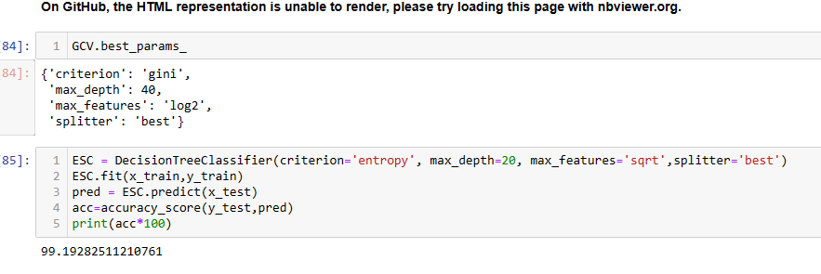
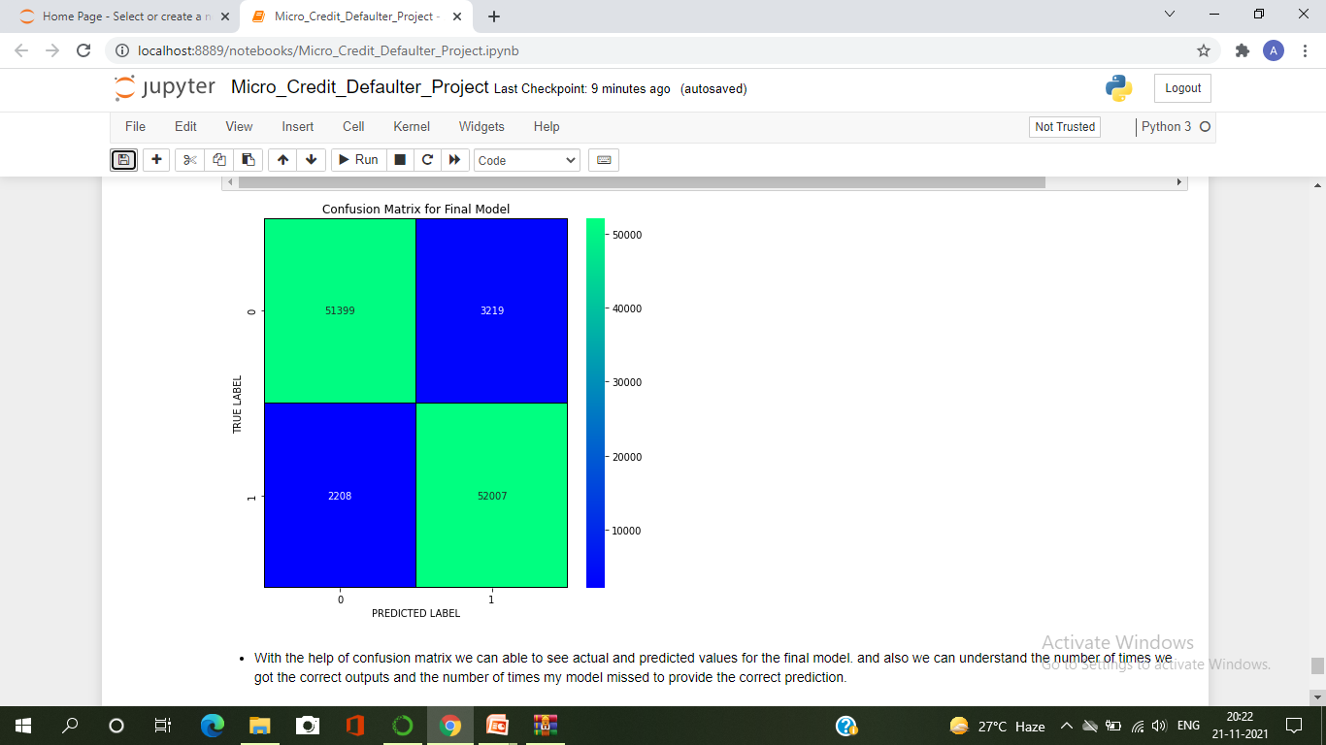
Creating Final Model After Tuning :
I have successfully incorporated the hyper parameter tuning using best parameters of Decision TreeClassifier and the accuracy of the model has been increased by 6% after hyper parameter tuning and received the accuracy score as 99 % which is very good.
With the help of confusion matrix we can able to see actual and predicted values for the final model . And also we can understand the number of times we got the correct output and the number of times my model missed to provide the correct prediction.

Slide 22
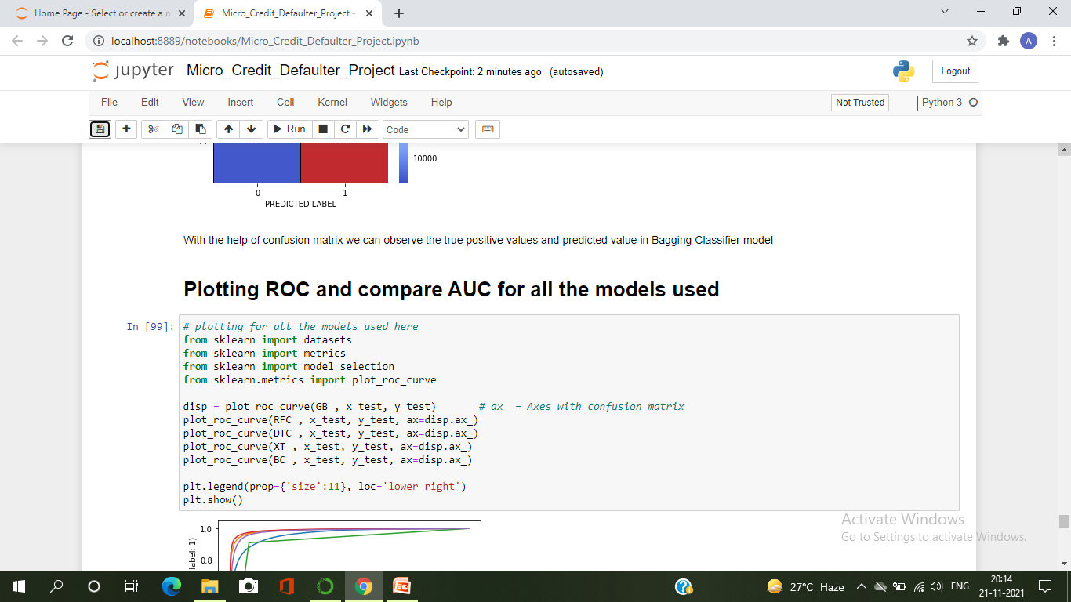
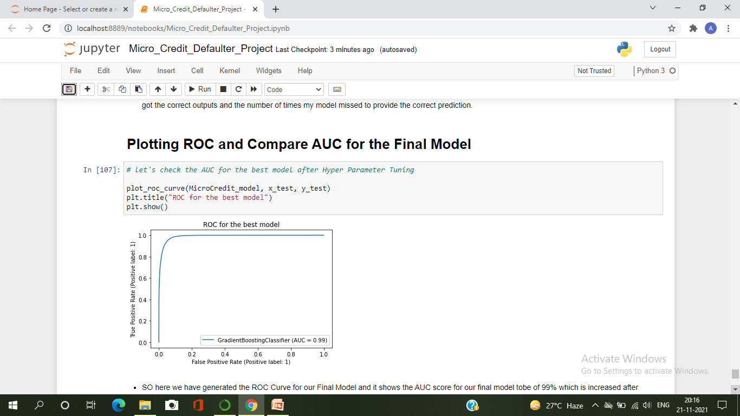
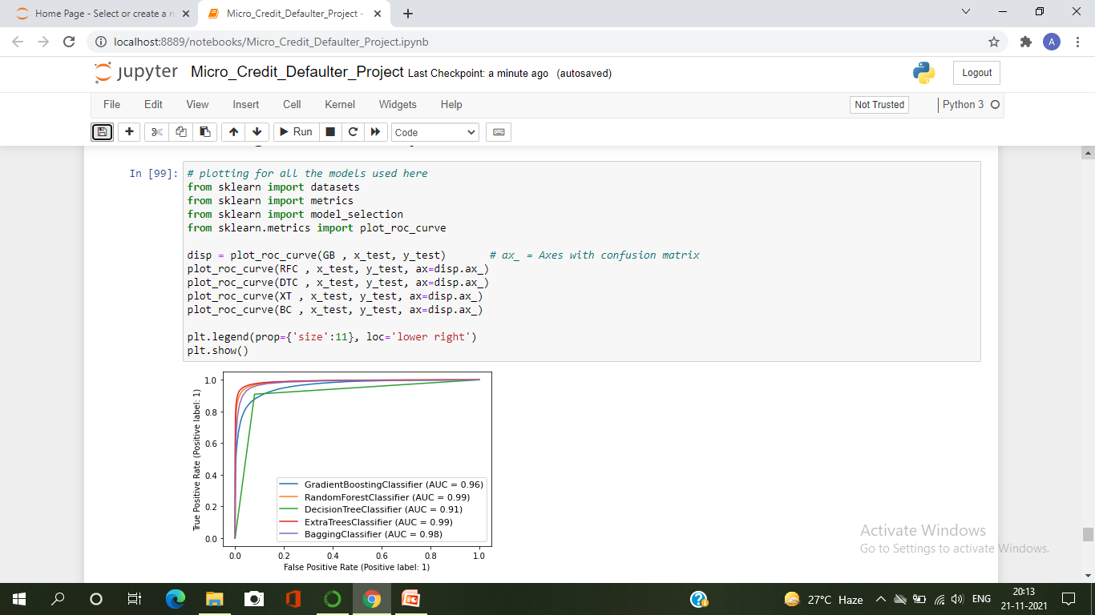
ROC-AUC Curve for all the models and for the best model :
I have generated the ROC Curve for all the models and for the best model and compared with AUC . The AUC score for my final model to be of 99% which is increased after tuning the model as it can be observed from the curves.

Slide 23
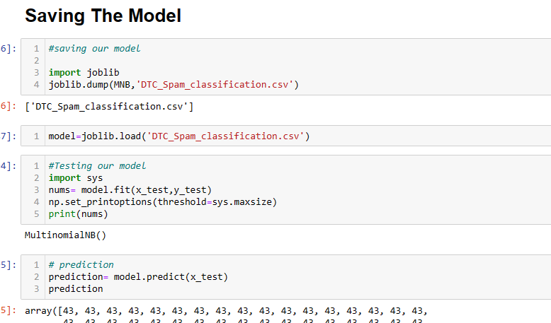
Saving The Final Model And Predictions From Saved Model
I have saved my final best model using joblib library in .pkl format, and loaded saved model for predictions.
Using classification model , we have got the predicted values for Email spam classifier. From the predictions we can notice both actual values and predicted values are almost same.

Slide 24
Conclusion
This case study aims to give an idea of applying EDA in a real business scenarioIn this project, I have done some feature engineering by replacing the unwanted entries by suitable values, found no null values, and renamed the columns by giving new names. Visualized the data using count plot, factor plot, pie plot and distribution plot, also encoded the object data into numerical using label encoding method. Checked the statistical summary of the dataset and checked for skewness, outliers and correlation between the features.
First, we loaded the dataset and have done data cleaning and EDA process and pre-processing techniques like checking outliers, skewness, correlation, scaling data etc. And got better insights from data visualization.
Then we did the model training, building the model and finding out the best model on the basis of different metrices like Accuracy Score, Cross Validation Score , roc-auc score, f1 score etc. We tried ensemble techniques like Random Forest Classifier, Decision Tree Classifier, Extra Trees Classifier, Gradient Boosting Classifier, Bagging Classifier etc.

Slide 25

Conclusion
We got Decision Tree Classifier as the best model among all the models as it gave least difference of accuracy and cross validation score. On this basis we performed the Hyper Parameter Tuning to finding out the best parameter and improving the scores. The accuracy score increased after tuning . So we concluded the Decision Tree Classifier as the best algorithm as it was giving high accuracy and AUC after tuning.
After that we saved the model in a pickle with filename in order to use whenever we require . Then we loaded the saved file and predicted the values.
Overall we can say that this dataset is good for predicting the defaulters level using classification analysis and conclude that Decision Tree Classifier is the best working algorithm model we obtained. We can improve the data by adding some more features.

Slide 26


